Slide 1

Notes:
Acknowledge that challenges and conflicts are normal in teams.

Slide 2
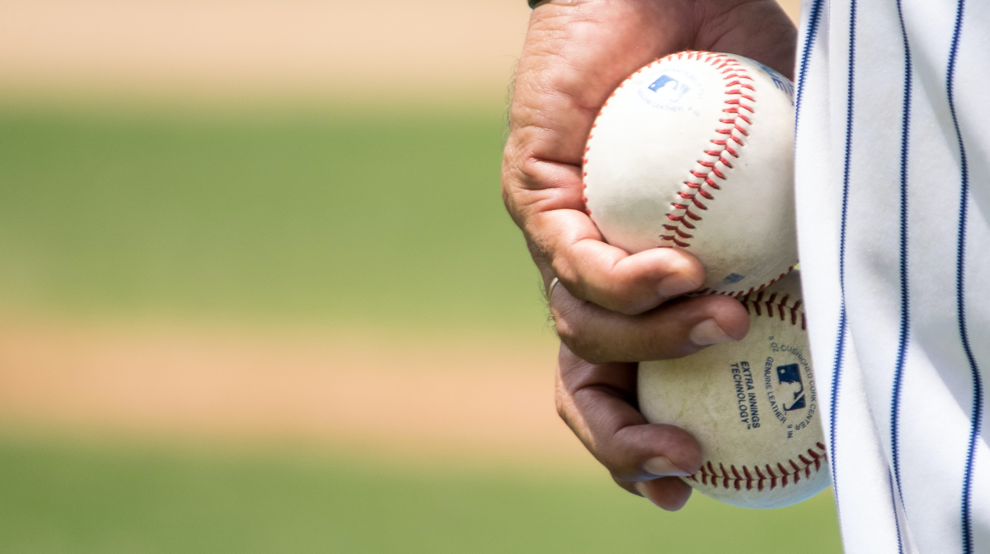
Notes:
Offer strategies for resolving conflicts respectfully and professionally.
—Address the issue early

Slide 3

Notes:
—Address the issue privately… Criticise in private praise in Public

Slide 4

I statement
Notes:
- Use the I statement “I Feel”… Avoid accusing “You always”

Slide 5
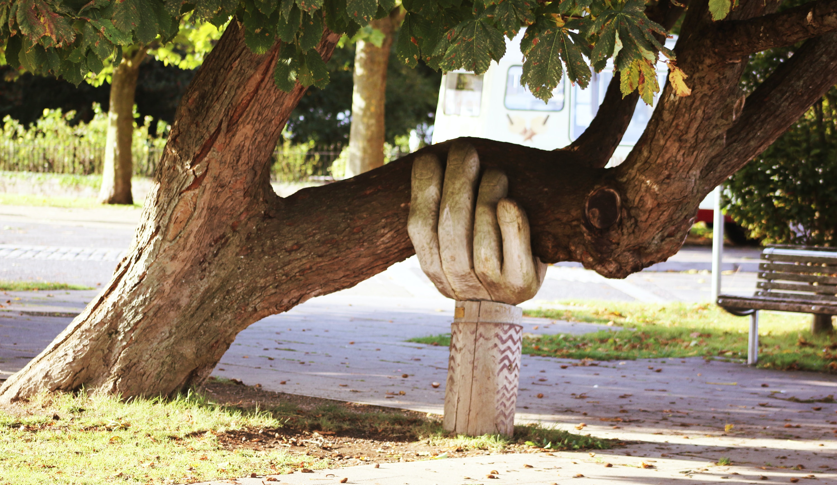
Notes:
Emphasise the importance of seeking support from mentors or supervisors when needed.

Slide 6

The orange negotiation
Notes:
Group Dynamic: Negotiation Team Building Activity (The most successful negotiators begin to collaborate with the other team instead of fighting harder for the last orange.)

Slide 7

Timelines & DeadLines

Slide 8
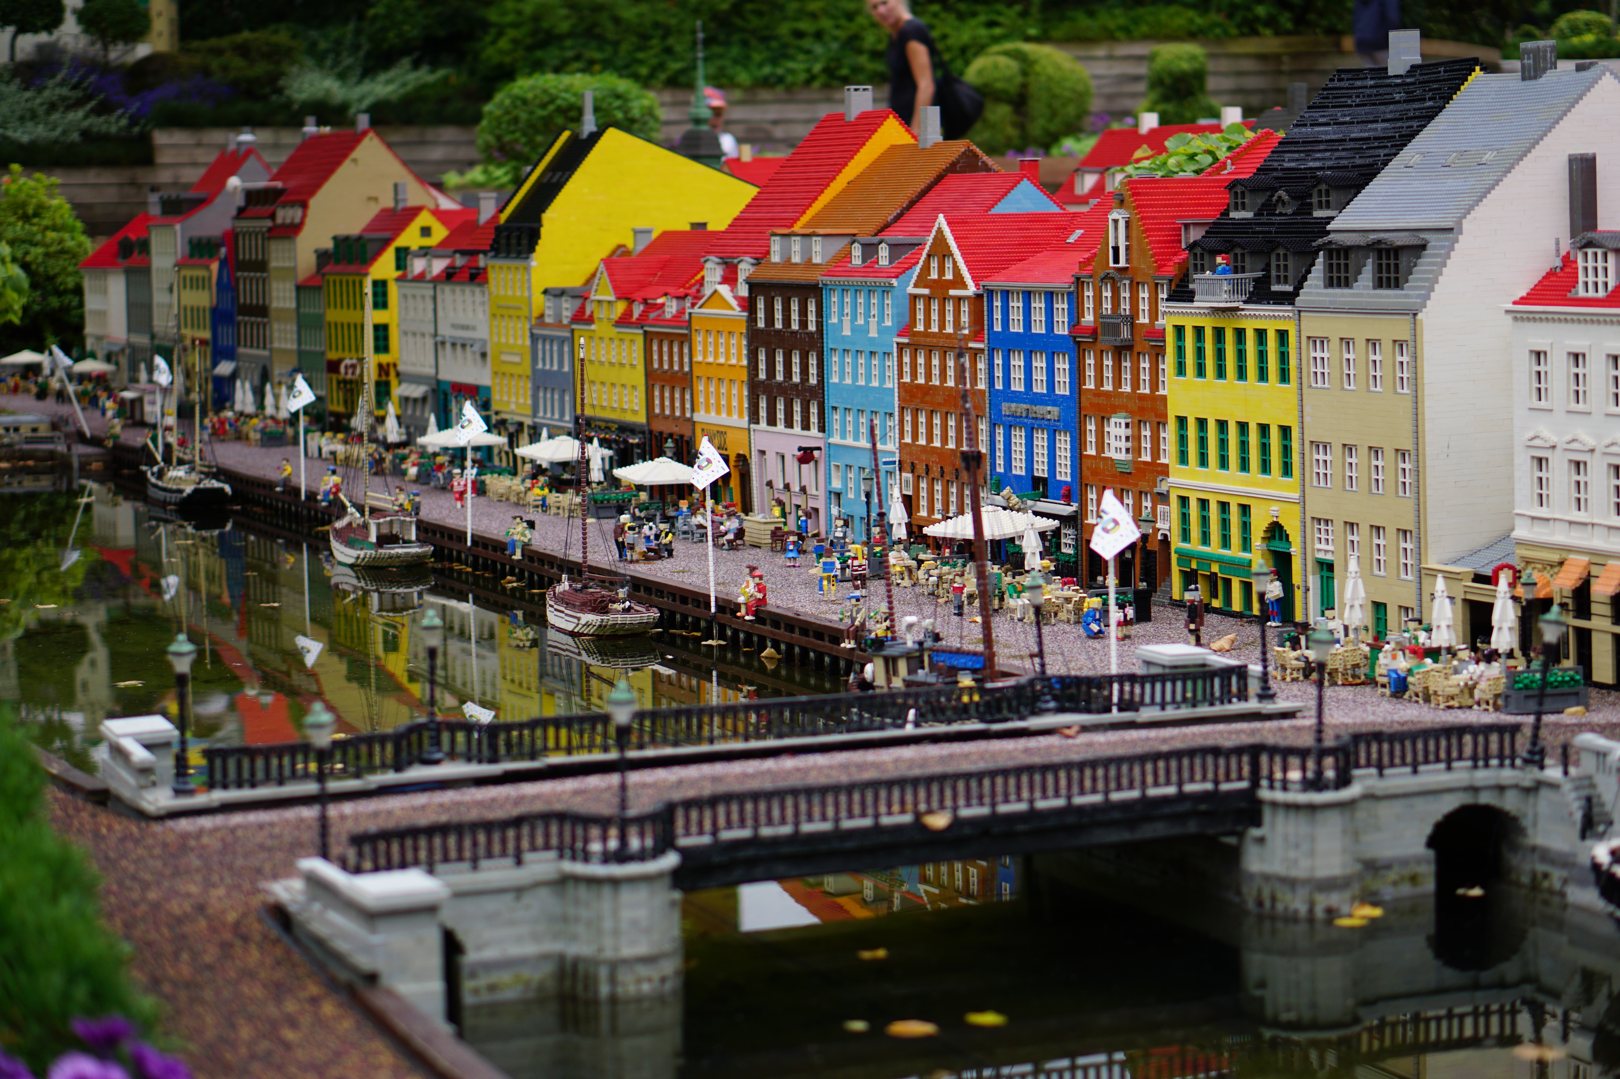
Notes:
Importance of negotiation. Is the project feasible and doable?

Slide 9
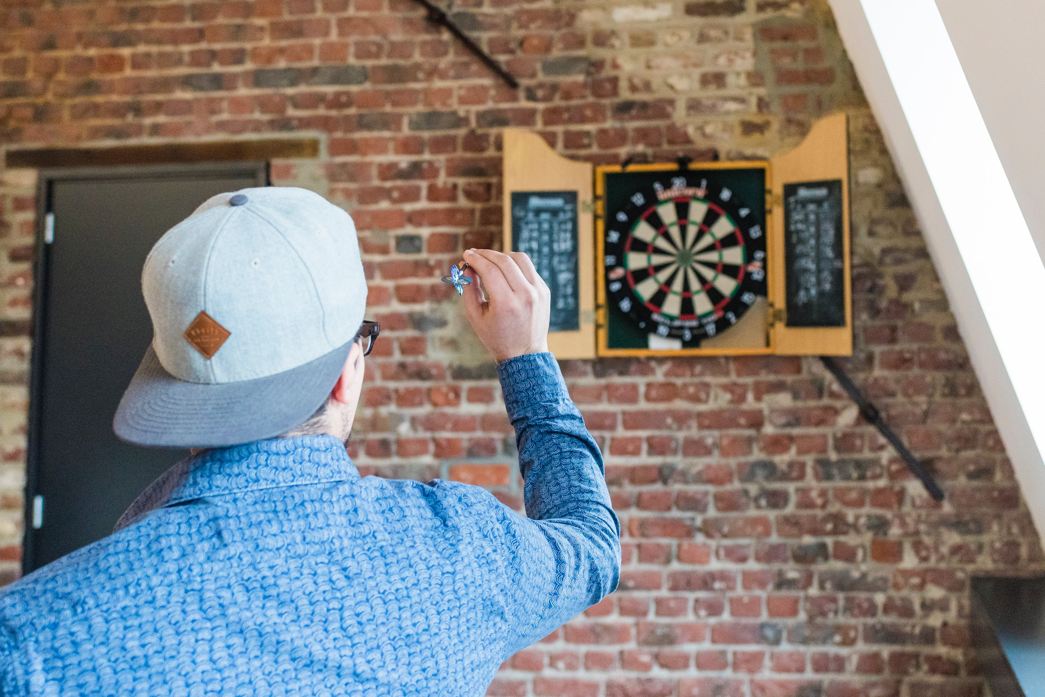
Notes:
How to estimations?

Slide 10
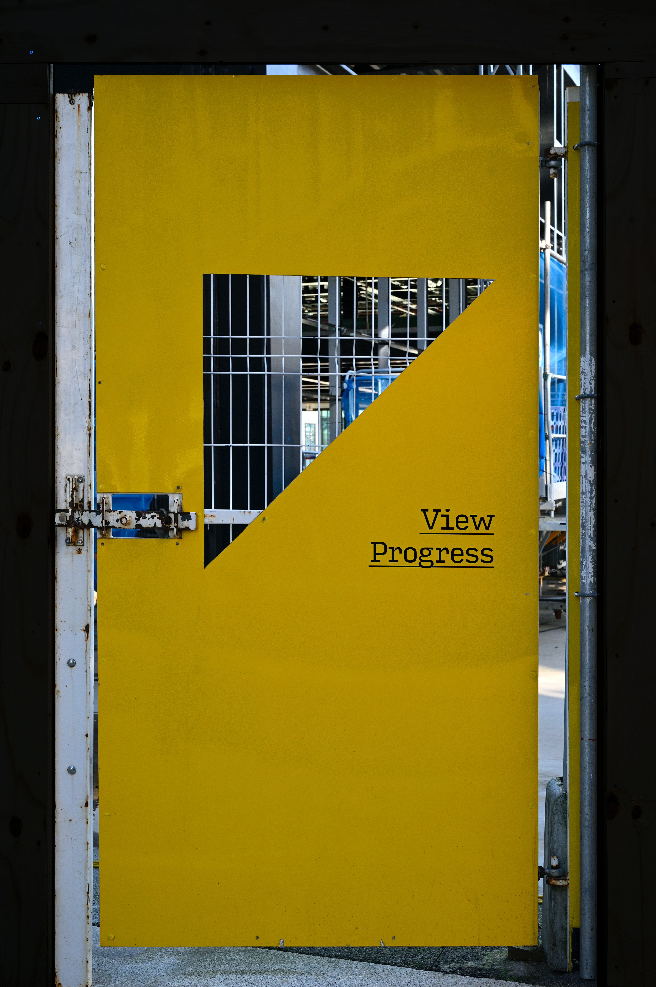
Notes:
Keep reports transparent.

Slide 11
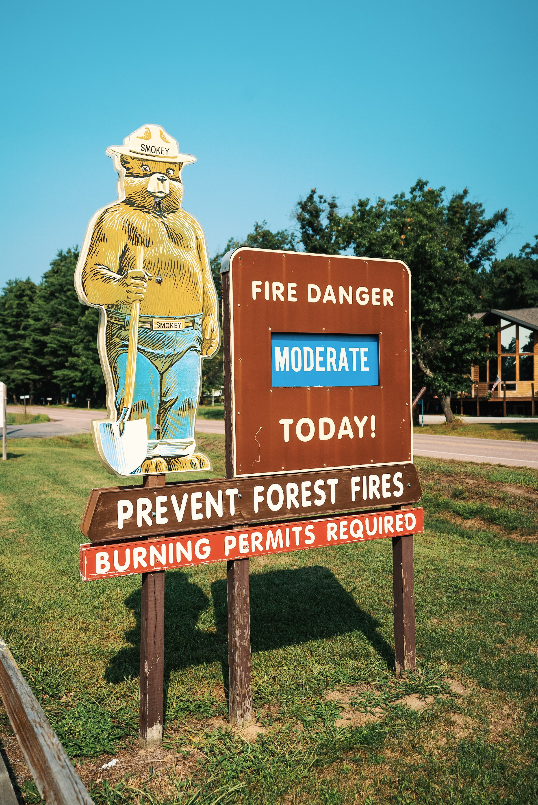
Notes:
How to identify risks and mitigate them.

Slide 12
QUIZ TIME
Notes:
Who can give me 3 take aways of todays seminar?

Slide 13

Thank you!
Notes:
Thank you!

